Slide 1
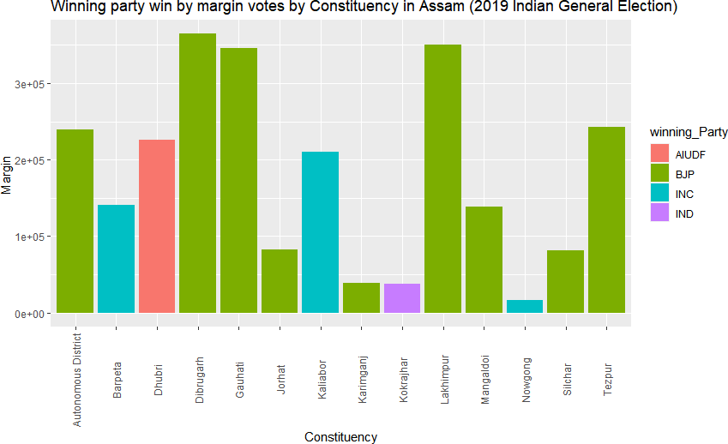
LOKSABHA ELECTION ASSAM -2019
THIS GRAPH SHOWS Winning Party Win Margin Constituency Wise in Assam and also show which party won in assam

Slide 2
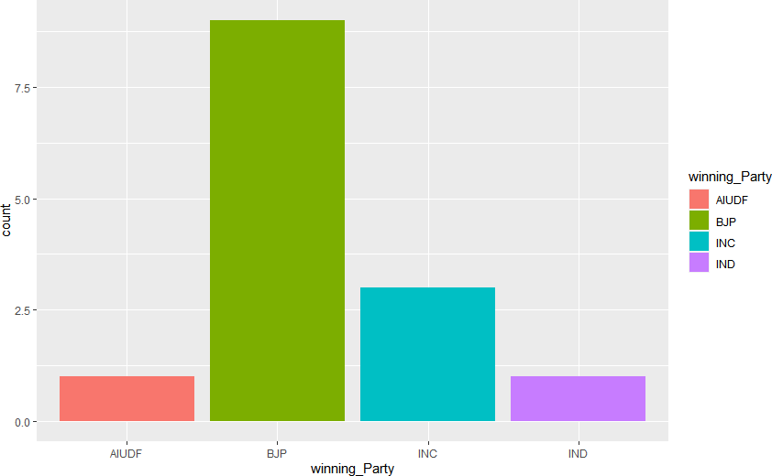
THIS GRAPH SHOWS Winning Party Name and no of seats each parties Win in Assam Lok Sabha Election 2019.

Slide 3
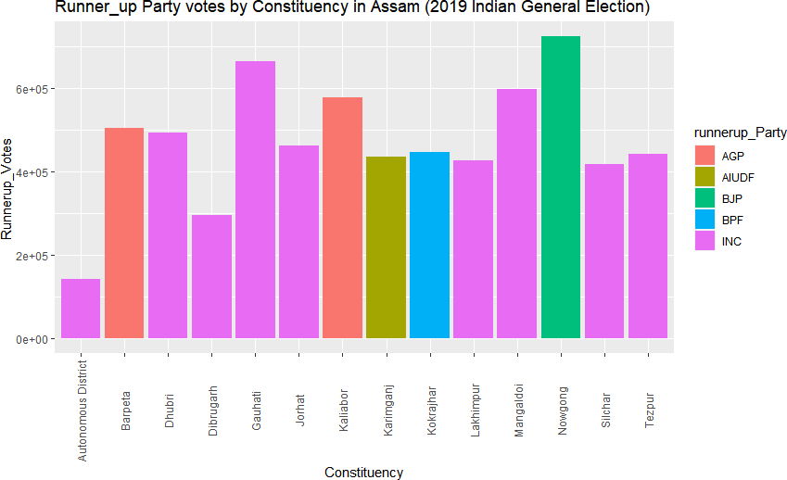
THIS GRAPH SHOW WHICH PARTY ARE RUNNERUP PARTY CONSTITUENCY WISE IN ASSAM AND ALSO SHOWS HOW MUCH VOTES EACH PARTY GET

Slide 4
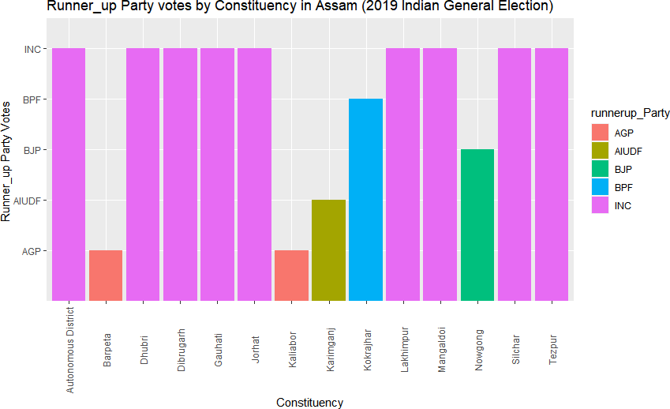
THIS GRAPH SHOWS Constituency wise Runnerup Party Name.in loksabha election 2019 in assam

Slide 5
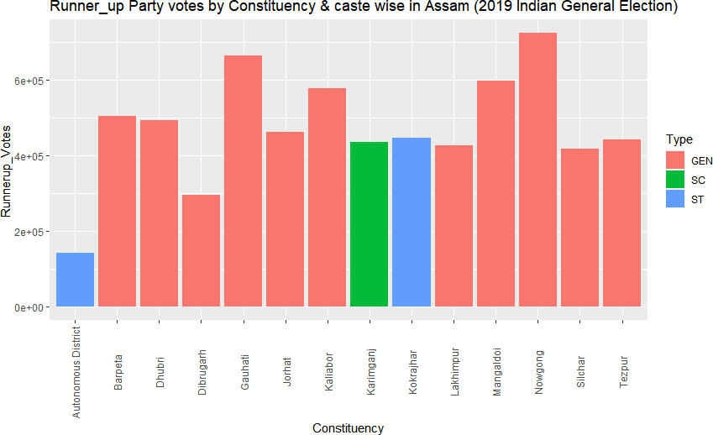
THIS GRAPH SHOWS Runnerup Party votes Constituency Wise and caste wise in each Constituency. And how much votes runner party gots in each constituency.

Slide 6
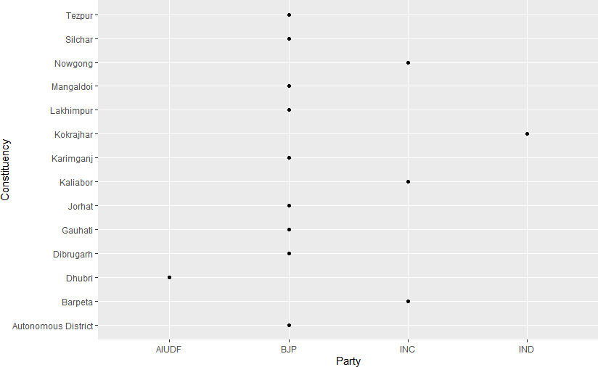
THIS GRAPH SHOWS Winning Party Name and Constituency wise seats each parties Win in Assam Lok Sabha Election 2019.

Slide 7
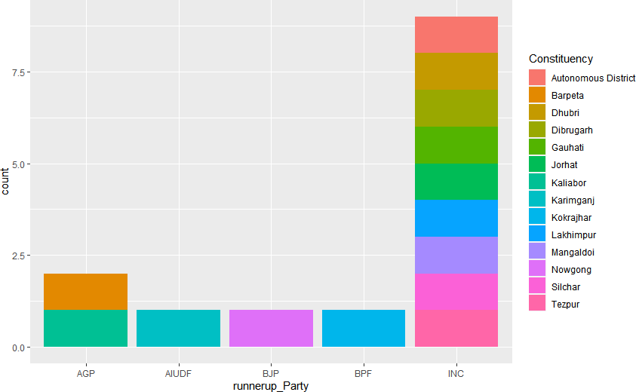
THIS GRAPH SHOWS Runnerup Party name and no of seat Constituency Wise.

Slide 8
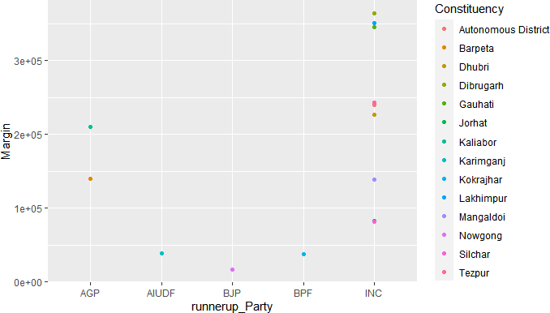
THIS GRAPH SHOWS Runnerup-Party Name and no of seats each parties lose and what margin they lose it in Assam Lok Sabha Election 2019.

Slide 9
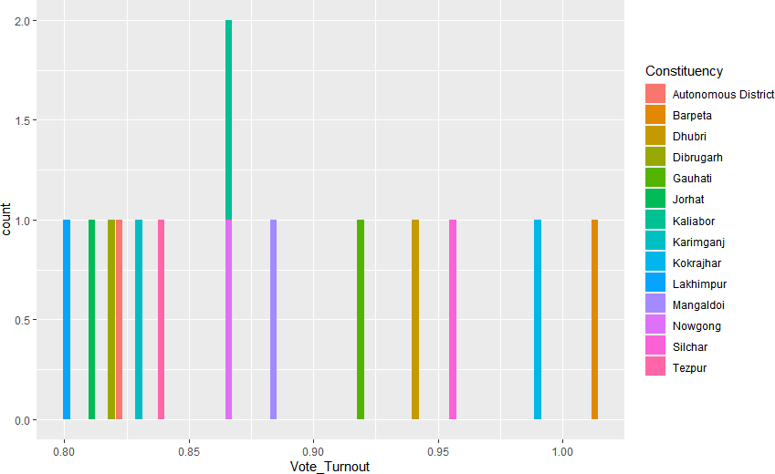
THIS GRAPH SHOWS Vote_Turnout constituency wise in Assam Lok Sabha Election 2019.

Slide 10
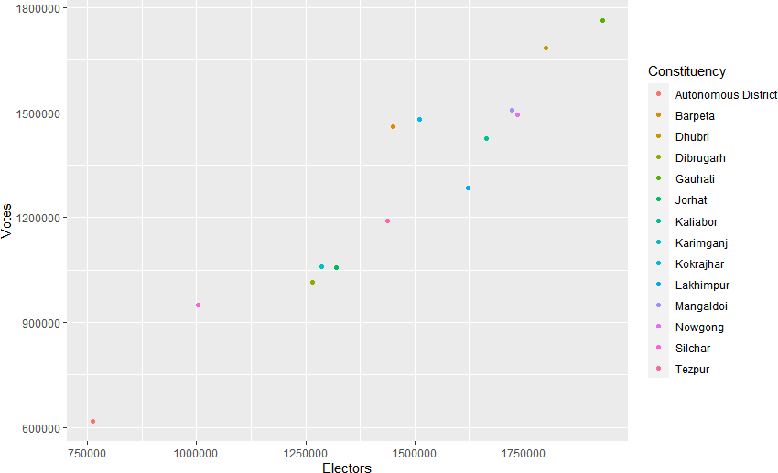
THIS GRAPH SHOWS Total no of voters in each Constituency and Total no of Votes polled in each Constituency in Assam Lok Sabha Election 2019.

Slide 11
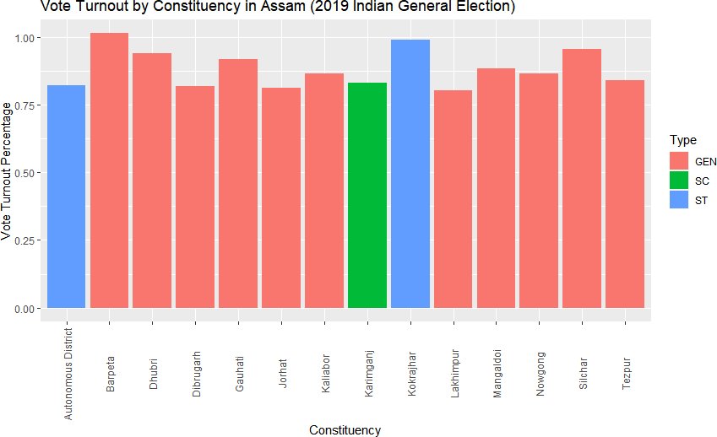
THIS GRAPH SHOWS Vote Turnout Percentage Constituency Wise and caste wise in each constituency in Assam Lok Sabha Election 2019.

Slide 12
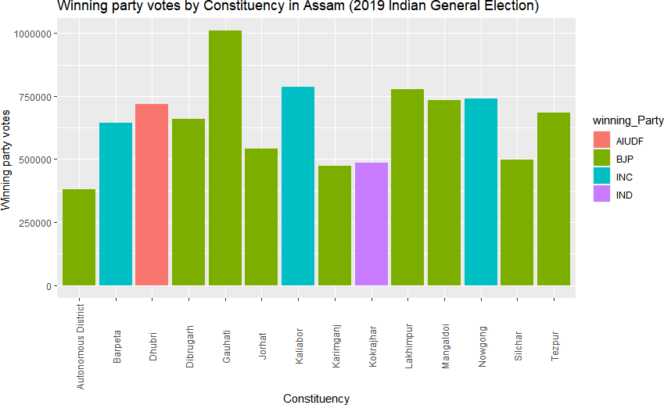
THIS GRAPH SHOWS Winning Party Got Constituency wise how much votes and also shows which party won in which constituency and no of seats Won by which parties we clearly predict from this graph.

